Slide 1
Elastic beanstalk
Testing deployment of webapp using aws elastic beanstalk

Slide 2
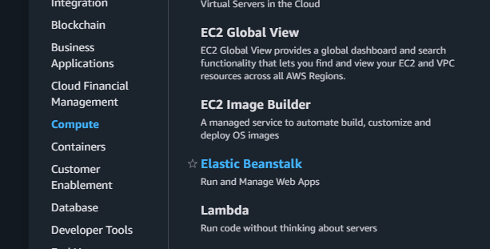
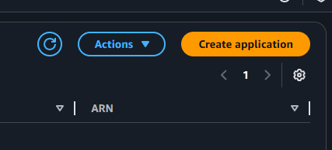
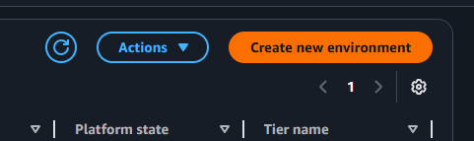
So I started up navigating to elastic beanstalk and created new environment

Slide 3
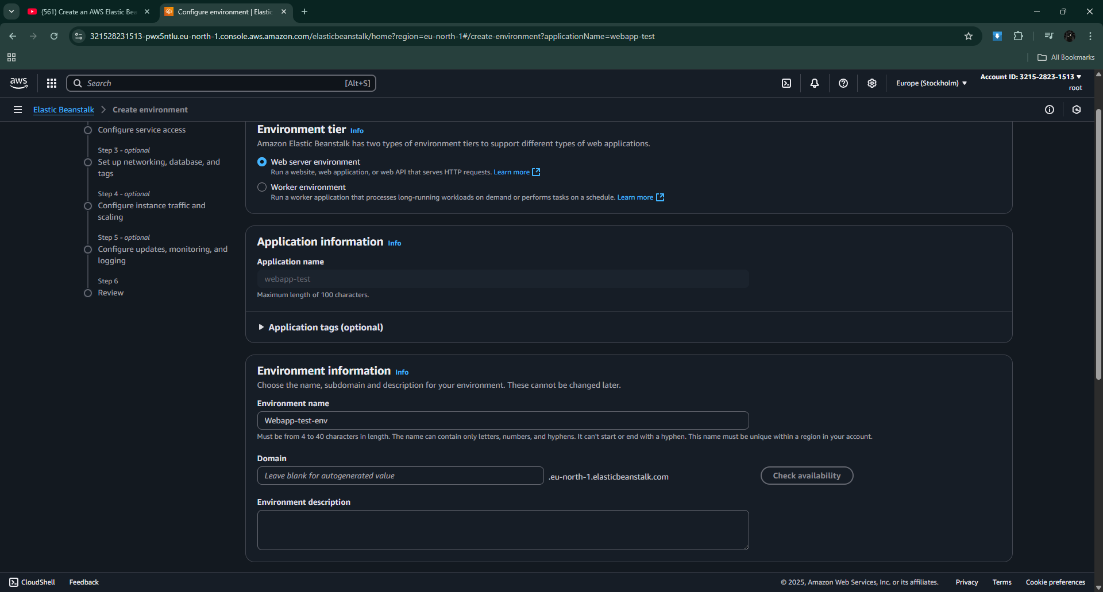
Selected webserver environment then I filled up other settings in it

Slide 4
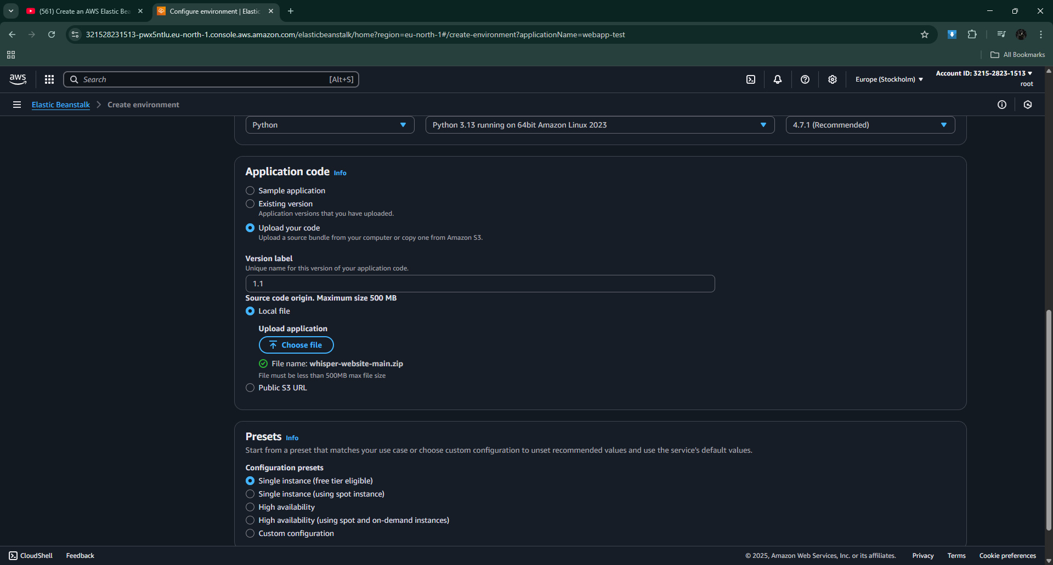
Then I chose the platform as python and there were multiple options you can select from like sample application which is provided by aws for testing purposes but I chose upload your code because I had a source code with me.

Slide 5
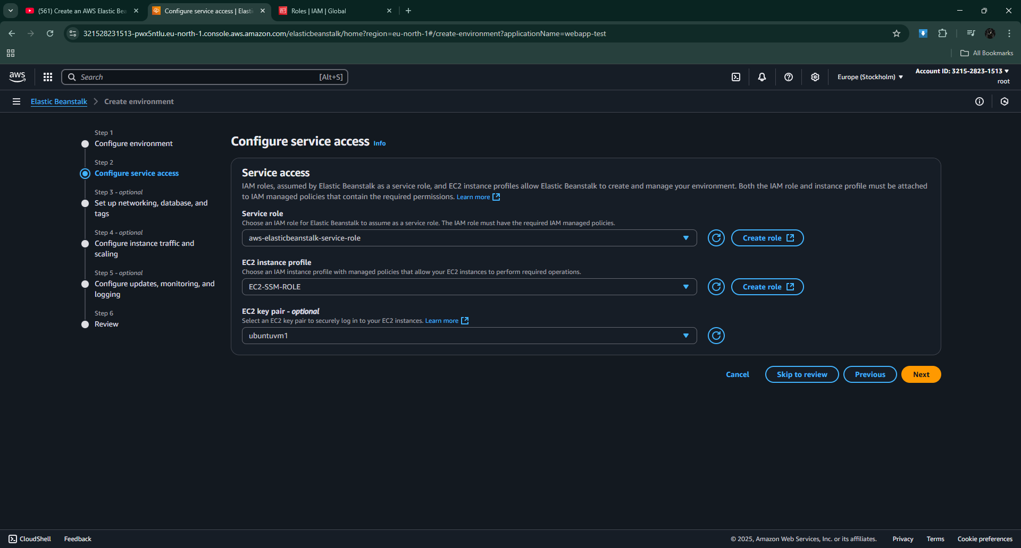
Then I configured service access settings I chose the preset service role for my testing purpose

Slide 6
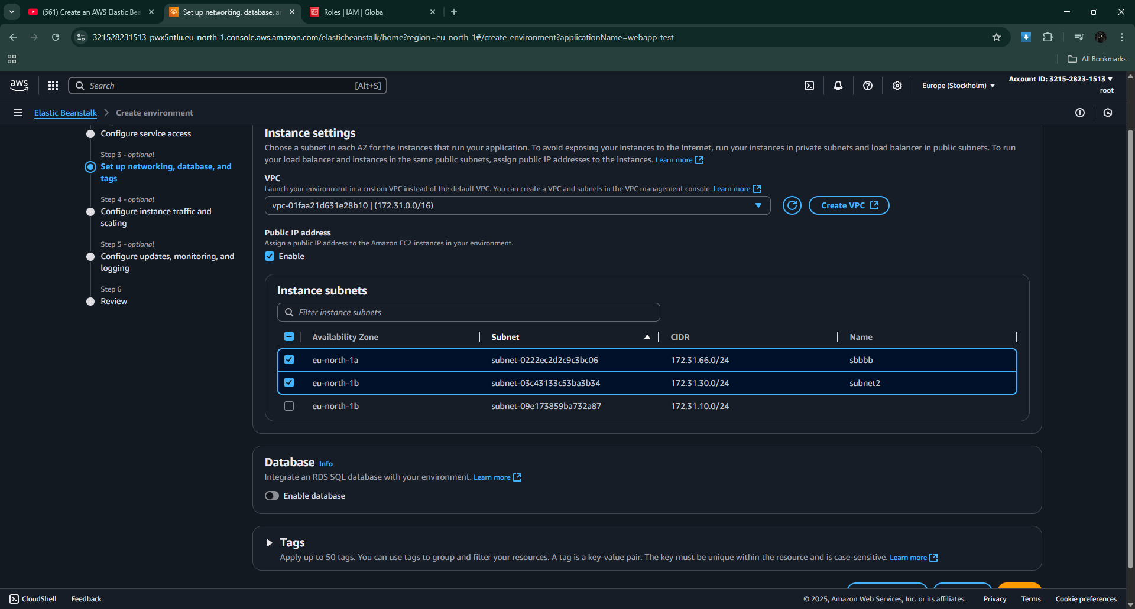
Then I selected the vpc I created for beanstalk and its subnets. I didn’t chose any databases.

Slide 7
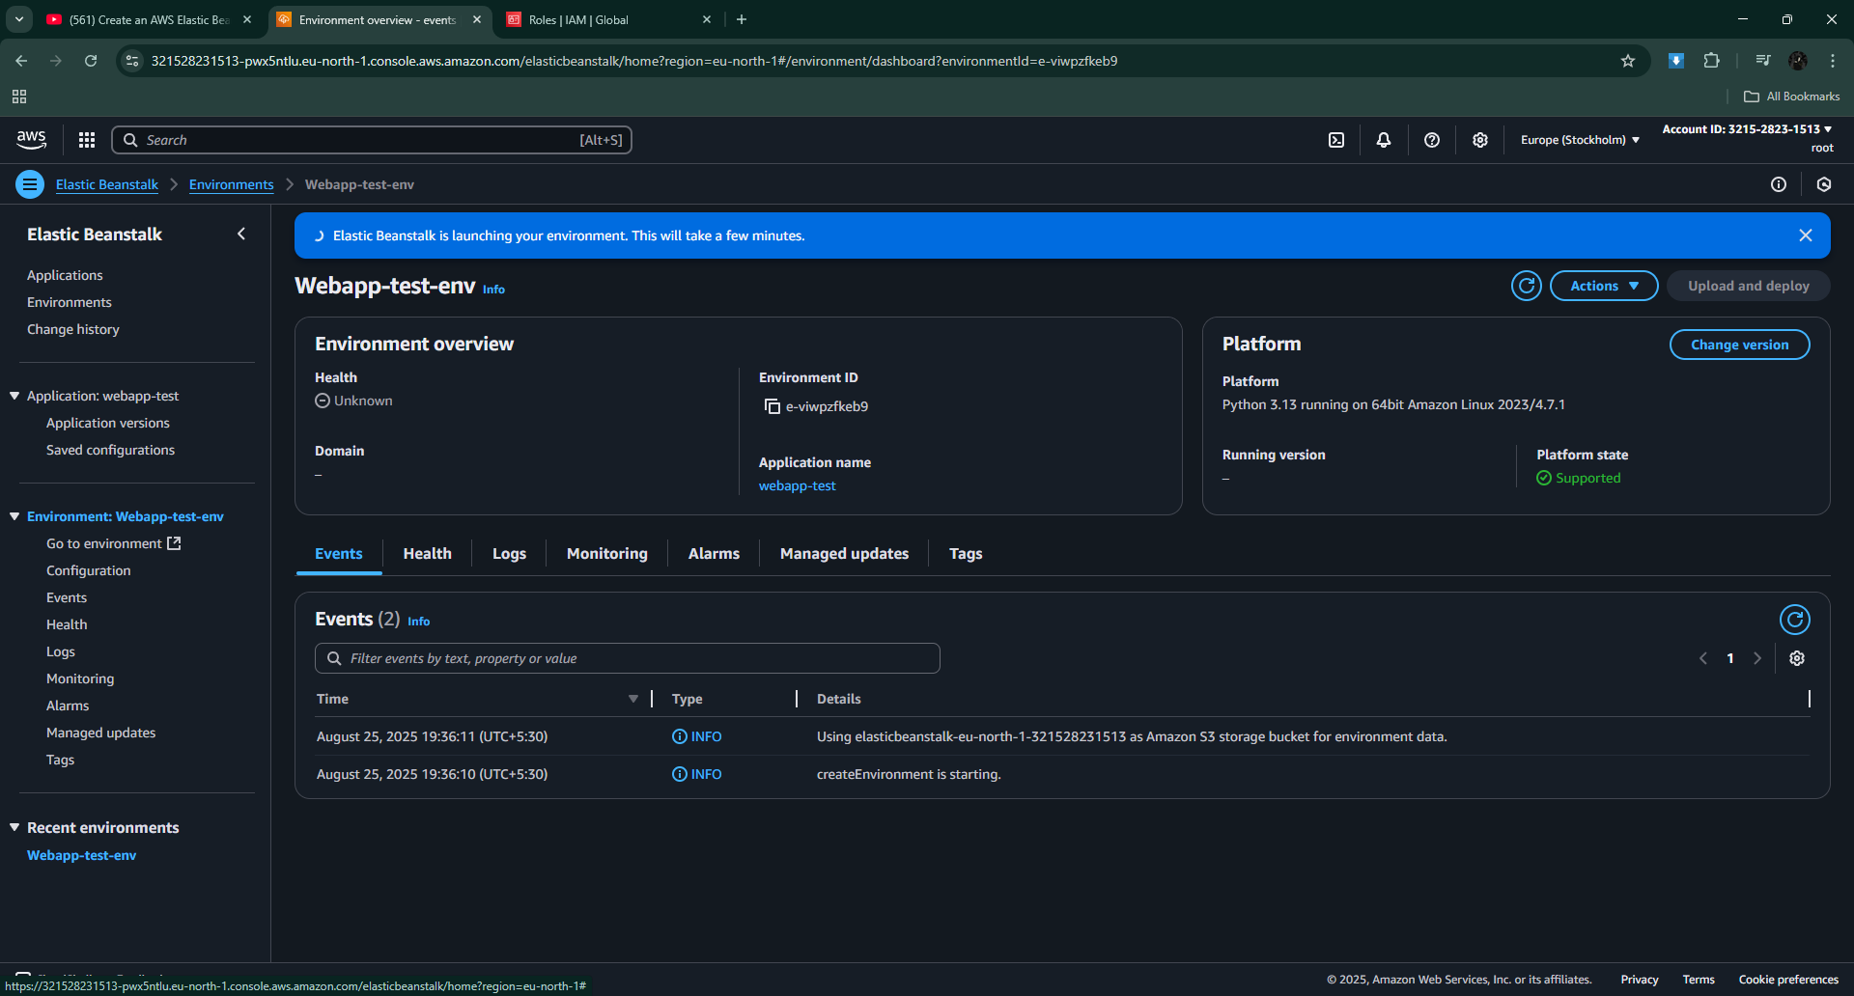
Then there was monitoring settings for the environment after that I successfully created the environment. We could also see its stacks if we went to the cloud formation page.

Slide 8
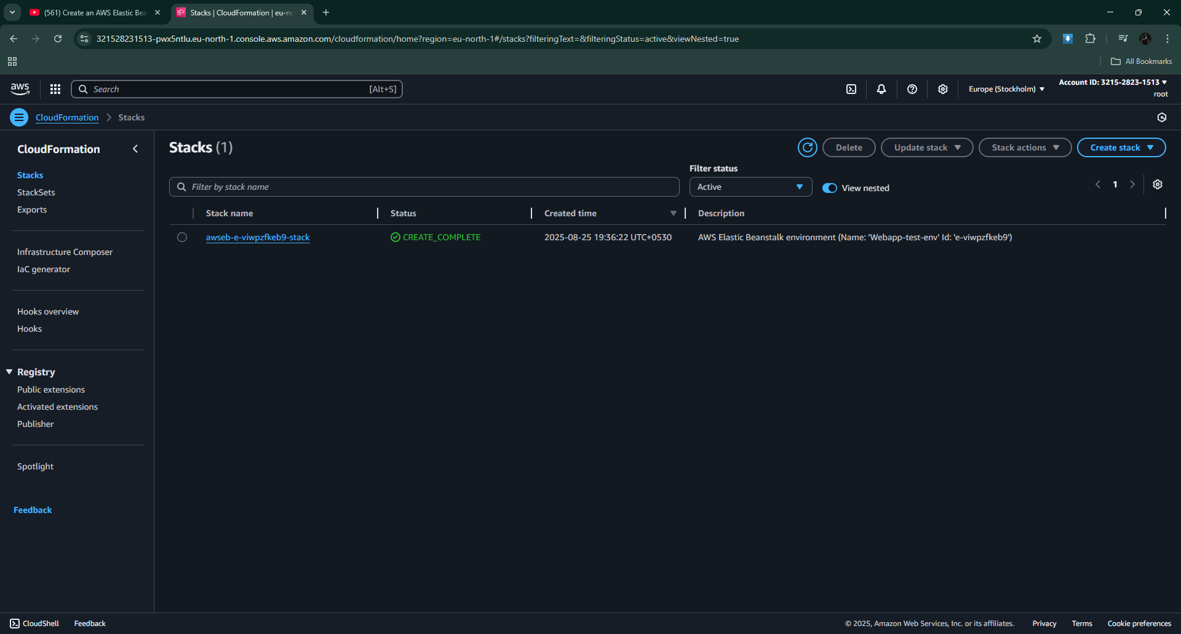
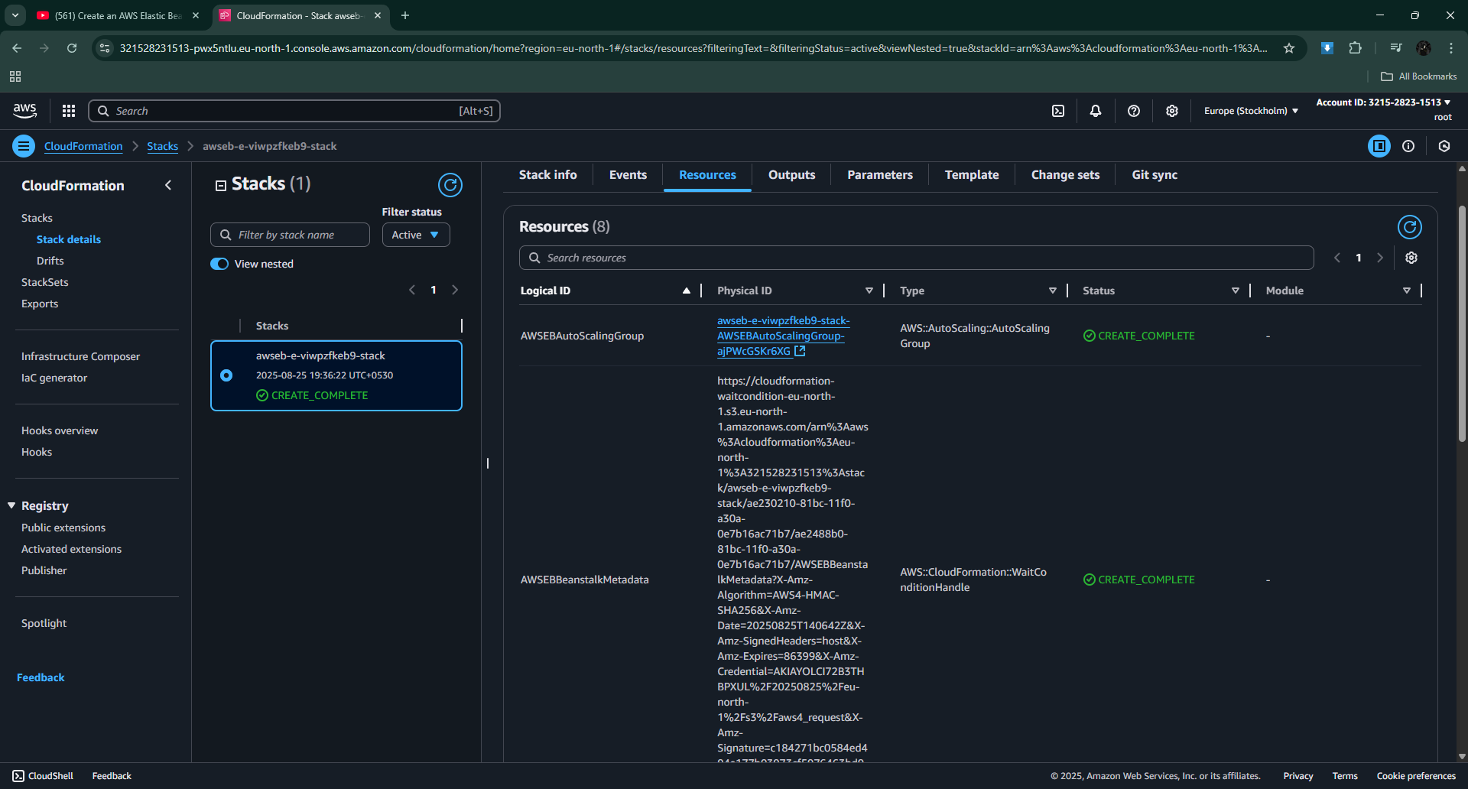

Slide 9
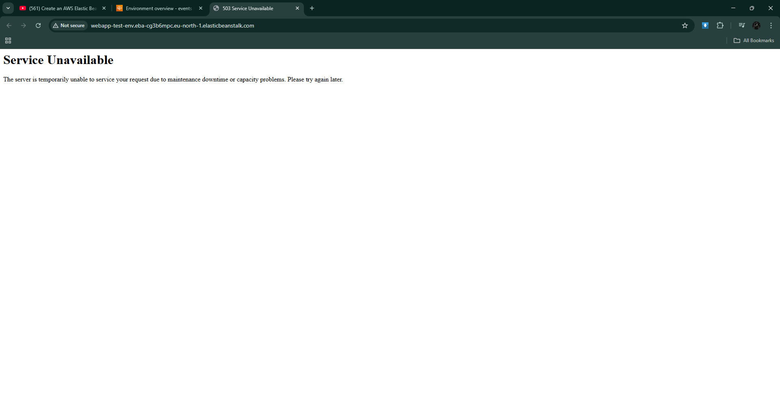
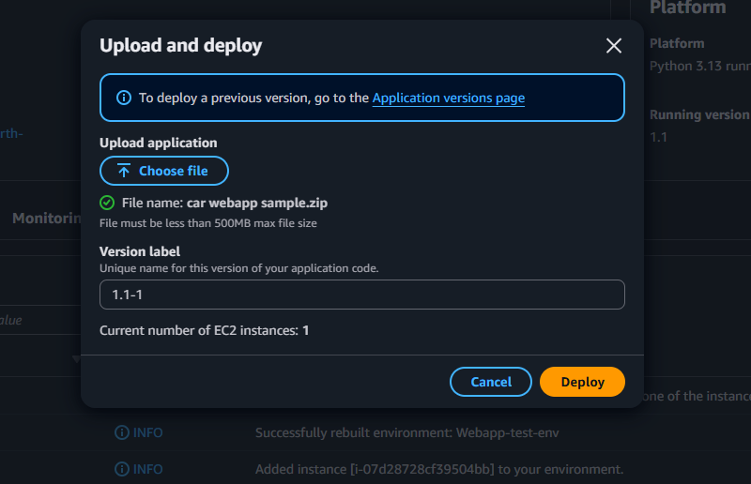
Then I tried accessing my application but I kept getting the this service unavailable message. So I checked different things such as vpcs subnets security groups etc. so the problem was with my source code. There is a specific format for beanstalk to recoginise the application from the zip file. So I made some changes to the formats and order of the zip file then rezipped it and redeployed it

Slide 10
